Slide 1

Landingspage
On the landingspage, the client has to make a choice for which option he wants to choose. Only further is it where they choose men or woman
Welcome to the online orderingportal of Piedro
Choose your form
Checboxes: When chekbox is clicked then open in order 1,2,3,4
1
Lasts
2
Upper
4
Lining shoes
2
Supplements
3
bottom

Slide 2
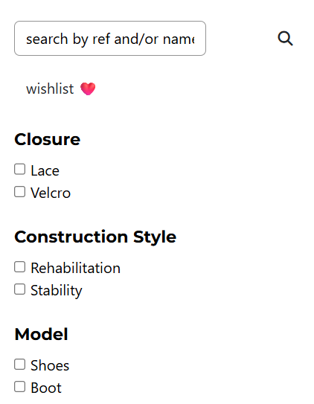
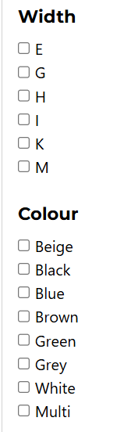
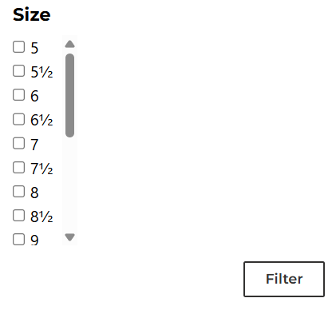

Slide 3
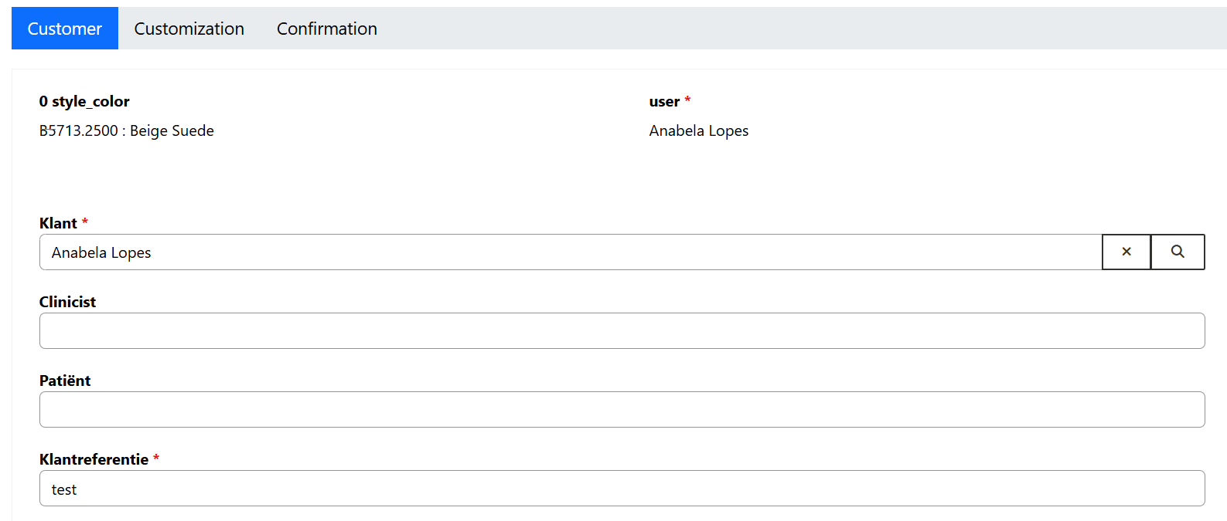
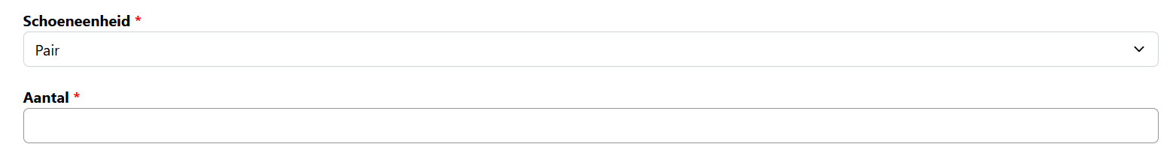
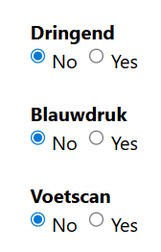

General information
Stay
Go
New
Move
Default pair, you can choose for one side
Move to lasts form

Slide 4
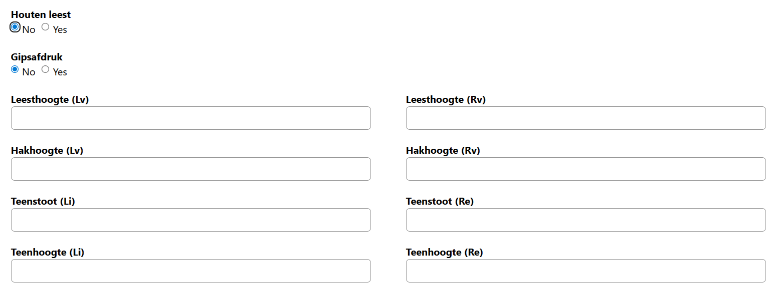

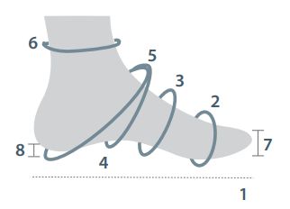
Lasts form
Stay
Go
New
Move
Change to sample below
Change to sample below
Change into sample below
Last measurements
mm | 1. | mm
mm | 2. | mm
mm | 3. | mm
mm | 4. | mm
mm | 5. | mm
mm | 6. | mm
mm | 7. | mm
mm | 8. | mm
Meetpunten
1. | Voetlengte
2. | Balomvang
3. | Lage wreef
4. | Hoge wreef
5. | Hielmaat
6. | Enkelmaat
7. | Teensprong
8. | Hielheffing
Teenhoogtes/toe hights
mm | I | mm
mm | II | mm
mm | III | mm
mm | IV | mm
mm | V | mm

Slide 5

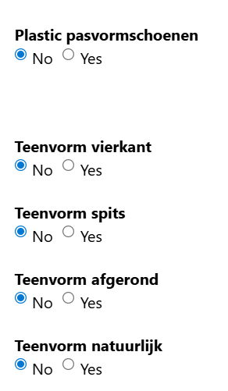
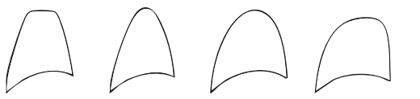
Lasts form
Insert checkbox:
With supplement (default)
Without supplement
Square
Pointed
Rounded
Nature
Replace with checkboxes:

Slide 6
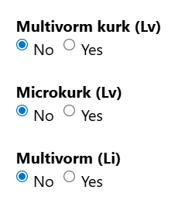
Supplements form
Replace with checkboxes:
Client clicks checkbox L, dropdown with materials.
When L is filled in then by default fill in R, but it can also be different.
Material:
L
R
Dropdown
Multiform/corck
Multiform/corck
Microcorck
Microcorck
Multiform
Multiform

Slide 7
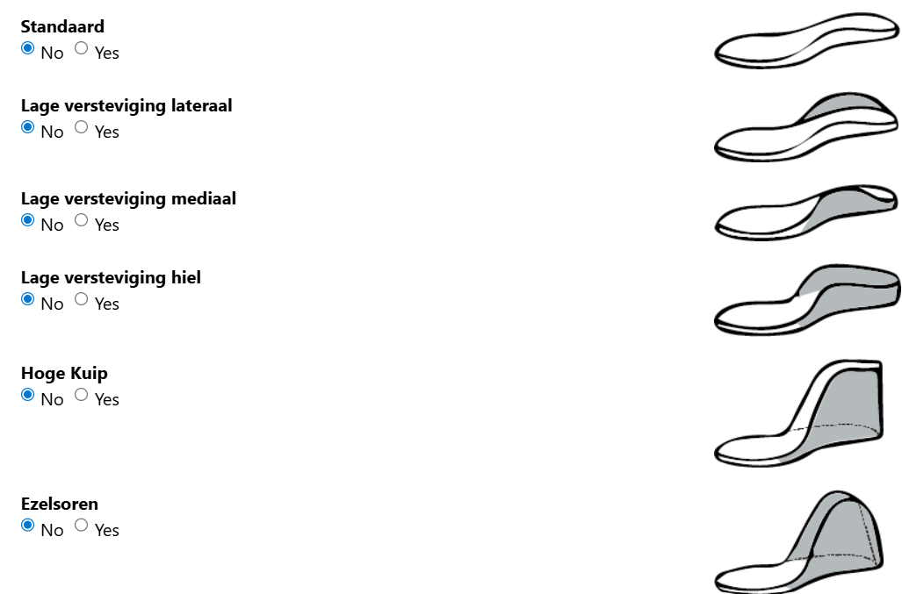
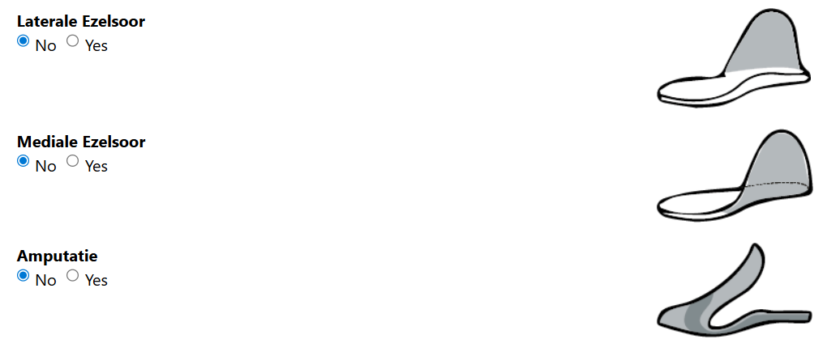
Supplements form
Client needs to check L and R
There are no defaults in this checkboxes
L
R
Choose supplements
Standard
Standard
Low reinforcement lateral
Low reinforcement lateral
Low reinforcement medial
Low reinforcement medial
Low reinforcement medial/lateral
Low reinforcement medial/lateral
High reinforcement medial/lateral
High reinforcement medial/lateral
High reinforcement medial/lateral open achilles
High reinforcement medial/lateral open achilles
High reinforcement lateral
High reinforcement lateral
High reinforcement medial
High reinforcement medial
Tongue supplement amputation forefoot
Tongue supplement amputation forefoot

Slide 8
Supplements form
Dropdown low reinforcement
Lateral
10 mm
15 mm
20 mm
25mm
30 mm
35 mm
40 mm
45 mm
50 mm
55 mm
60 mm
Dropdown low reinforcement
Medial
10 mm
15 mm
20 mm
25mm
30 mm
35 mm
40 mm
45 mm
50 mm
55 mm
60 mm
Dropdown low reinforcement
Lateral | Medial
10 mm | 10 mm
15 mm | 15 mm
20 mm | 20 mm
25mm | 25 mm
30 mm | 30 mm
35 mm | 35 mm
40 mm | 40 mm
45 mm | 45 mm
50 mm | 50 mm
55 mm | 55 mm
60 mm | 60 mm
If checked, no dropdown
If checked dropdown
v
Standard
Low reinforcement lateral
Low reinforcement medial
Low reinforcement medial/lateral
High reinforcement medial/lateral
Only on high reinforcement
High reinforcement medial/lateral open achilles
Dropdown low reinforcement
Medial
65 mm
70 mm
75 mm
80 mm
85 mm
90 mm
95 mm
100 mm
105 mm
110 mm
115 mm
120 mm
Other
Dropdown low reinforcement
Medial
65 mm
70 mm
75 mm
80 mm
85 mm
90 mm
95 mm
100 mm
105 mm
110 mm
115 mm
120 mm
Other
Dropdown low reinforcement
Lateral | Medial
65 mm | 65 mm
70 mm | 70 mm
75 mm | 75 mm
80 mm | 80 mm
85 mm | 85 mm
90 mm | 90 mm
95 mm | 95 mm
100 mm | 100 mm
105 mm | 105 mm
110 mm | 110 mm
115 mm | 115 mm
120 mm | 120 mm
Other | Other
Checkbox:
Padding on ankle
Yes
No
High reinforcement lateral
If yes
High reinforcement medial
Dropdown padding on ankle
Lateral | Medial
3 mm | 3 mm
6 mm | 6 mm
Other | Other
Tongue supplement amputation forefoot
Specify materials in remark section

Slide 9
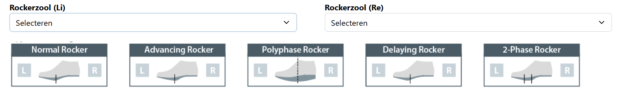
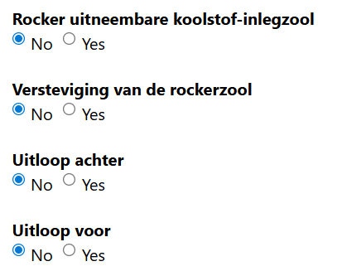


Supplements form
Keep this part including dropdown
Differnce in length of legs should be given in mm

Slide 10
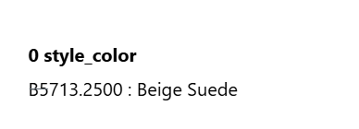
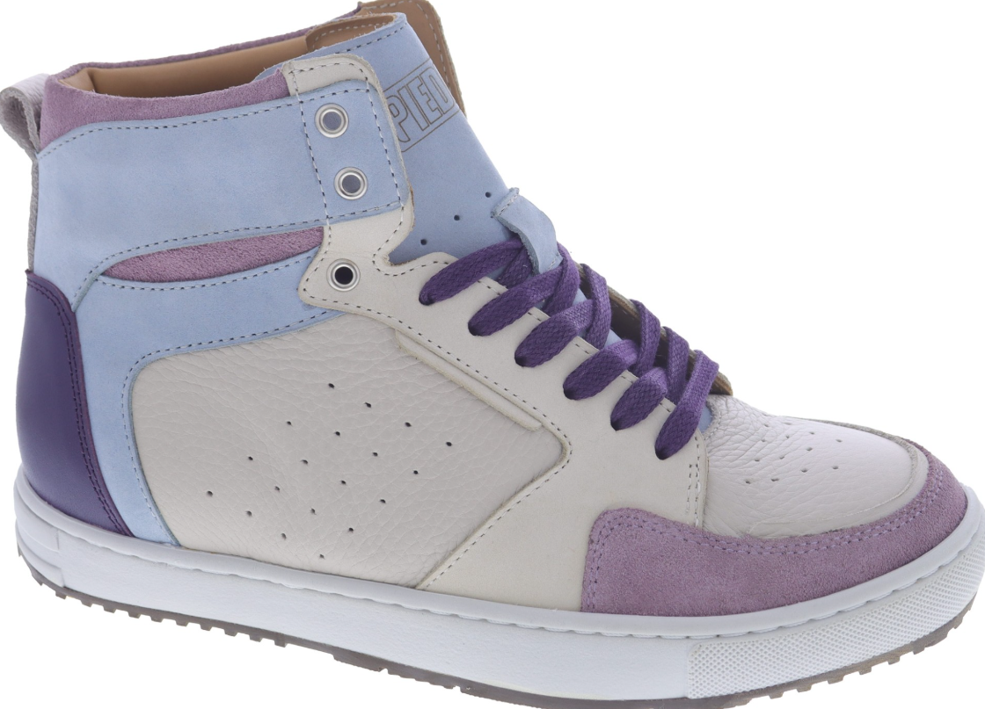
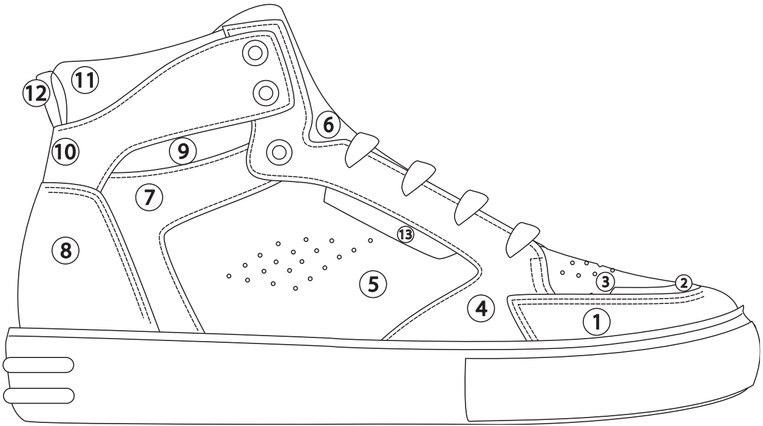

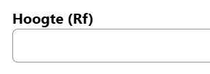
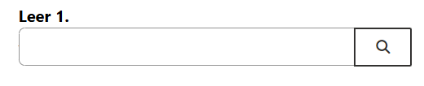
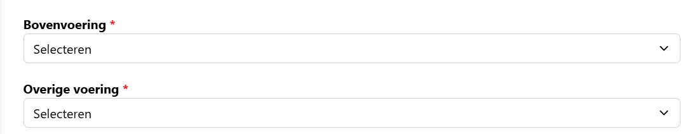
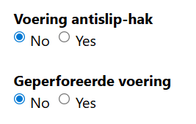
Upper form
If height is given in then, by default also fill in the heigt for the other side. But this must be adjustable
The amount of choices must be the same as the amount of choices there are in the picture in this case 13
If leather is given in then, by default also fill in the leather for the other side. But this must be adjustable
Change into: Lining including dropdown, only one option,.

Slide 11
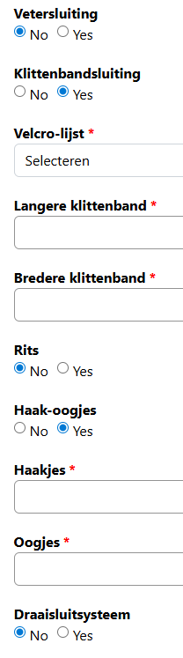
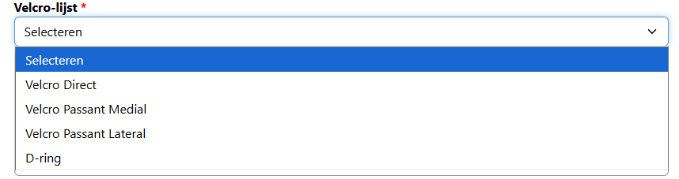
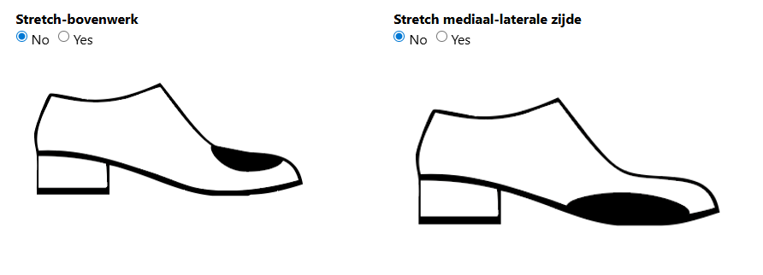
Upper form
Change sequence
Remove from dropdown: Velcro passant medial Velcro passant lateral
Add to dropdown: Velcro passant medial left Velcro passant lateral left
Velcro passant medial right
Velcro passant lateral right
2
1
1
2
6
7
5
3
Only show when this is possible to make
Longer velcro measured in mm
3
4
2
Width velcro measured in mm
4
5
3
If zipper yes: then dropdown
- Zipper along laces left medial
Zipper along laces left lateral
Zipper on side part left medial
Zipper on side part left lateral
Zipper along laces right medial
Zipper along laces right lateral
Zipper on side part right medial
Zipper on side part right lateral
5
4
6
6
Dropdown: 1,2,3,4,5,6, production decides
7
7
Dropdown: 1,2,3,4,5,6, production decides

Slide 12
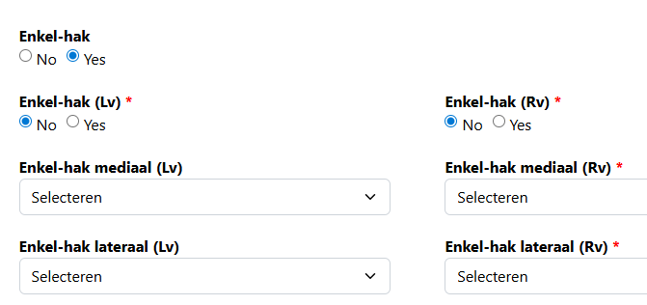
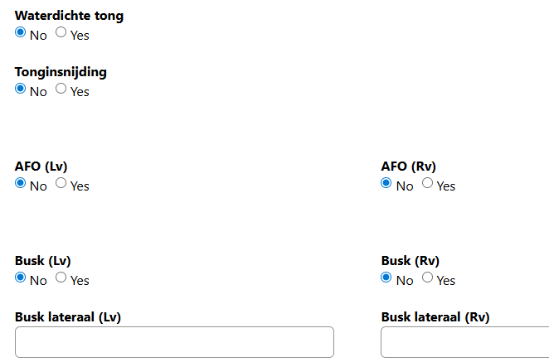
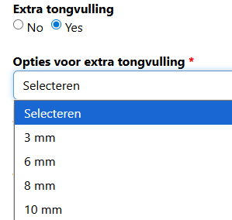
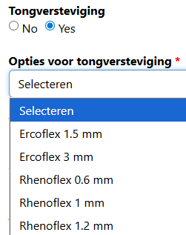
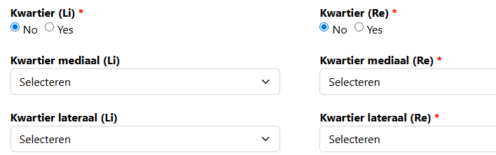

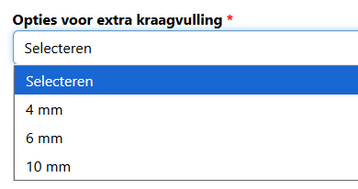
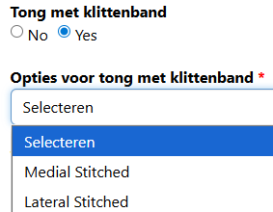
Upper form

